Slide 1
2023-2024
CFISD
Livestock Show Project Meeting

Slide 2
Supervising Teachers
Mrs. Cox & Mrs. Sadler
Poultry
Turkeys & Broilers
Goats
Lambs
Rabbits
Horticulture
Mrs. McKinney & Ms. Jay
Hogs
Steers
Heifers
Ag. Mechanics

Slide 3
Lamb, Goat, & Swine Entries will be available after this meeting
They are due by 2:40 pm on September 14th
Lamb & Goat turn into Swine go to
Mrs. Sadler or Mrs. Cox Mrs. McKinney or Ms. Jay

Slide 4
May only miss 2 FFA meetings.
Must pass all classes for the 2nd marking period.
Cannot be placed in ALC or DEAP.
If you are in ALC or DEAP during show time you will not be eligible to show.
If you are placed in ALC or DEAP or parent will have to feed and care for your animal during your placement.
Eligibility Requirements

Slide 5
Important Dates
9/14 - Entries Due by 2:40pm
9/26 - Goat, Lamb (Library),
Swine(Teaching Theater)
Workshops, 6:00 pm
Rabbits (Library), 7pm
10/4 - Goat, Lamb, & Swine
Lottery Draw - 4pm Telge
Exhibit Center
10/5 - Goat Selection
10/6 - Lamb Selection - Homecoming Game
10/7 - Swine Selection - Homecoming Dance
1/31 - CFISD Show Check in
2/1 - Rabbit, Lamb, Cattle Shows
2/2 - Poultry, Goat, & Swine Shows
2/3- Sale Day!

Slide 6
Swine
Entry & Barn App due date: September 14th by 3pm
Seminar date: September 26th @ 6:00pm in the teaching theatre
Draw: October 4th @ 4pm
Selection: October 7th Telge Exhibit Center

Slide 7
Swine
Cost
Hog: $350
Barn: $150
Supplies: $200-300
Feed & Shavings: $500-800
Total cost to raise a pig: around $1,200- $1,600
Key information:
Swine Entry form and barn paperwork and payments are due by September 14th at 2:45pm
Swine Seminar September 26th we will go over everything in detail

Slide 8
Remind 101 Swine
@swsquad
Text the code above to 81010 to join
FFA Calendar : http://www.cyfair.ffanow.org/AETcalendar.aspx?ID=10113

Slide 9
CFISD Ag Mechanics Show
Meeting: October 12 @6:00 pm
Classes:
DIVISION I: AGRICULTURAL MACHINERY & EQUIPMENT
CLASS 1: Hay Hauling, Spraying Equipment, Mounted and Pull Type Tractor Equipment, Self-Propelled Equipment, and Hydraulic Equipment
CLASS 2: Shop Tools and Equipment, Truck, Tractor, and Ag Equipment Accessories
CLASS 3: Livestock and Utility Trailers
DIVISION II: LIVESTOCK EQUIPMENT
CLASS 4: Gates, Livestock Panels, Squeeze Chutes, Livestock Restraining, Livestock Equipment, Trim Chutes, Block Stands, Livestock Crates, Head Gates, Saddle Racks,Tack Boxes, Tack
CLASS 5: Feeders, Self Feeders, Creep Feeders, Storage Buildings
CLASS 6: Wildlife Accessories
DIVISION III: HOME & YARD RECREATIONAL PROJECTS
CLASS 7: Home and/or Furniture
CLASS 8: Yard
DIVISION IV: NON-AG PROJECTS - BBQ PITS
CLASS 9: Free Standing BBQ Pits, Cooking Equipment
CLASS 10: BBQ Pit On Trailers
DIVISION V: INDUSTRIAL AGRICULTURE
CLASS 11: Logging Equipment
DIVISION VI: OIL & GAS
CLASS 12: Oil/water separators, pipe racks, skids
Available to ALL students in ag classes
Projects can be done individually or in groups (max 5)
Important Dates:
September 18 - Inform Ms. Jay you are doing a project.
November 26 - Entries due
January 31 - Check in
February 1 - Judging & awards
Start date will depend on the project!

Slide 10
Broiler (Chickens) - Total Cost +/- $900.00
Supplies Needed:
Shavings
Plywood
Fans
Heat lamps
Feeders & Feed
Waterers
Supplements
Official Dress
Official FFA Jacket
Official FFA Tie or Scarf
Black pants – jeans or dress pants
White collared s
Broiler Cost:
25 Broilers per Box - Price $45.00
25 minimum number you can order
Entry Fee - $25.00

Slide 11
Broilers Time Dedication
6 weeks - (Dec. - Feb.)
Including Christmas Break
Chickens must be stirred/moved around multiple times a day and during the night.
***This project must be kept at your house in your garage or enclosed building.

Slide 12
Broilers
Dates:
October 10th - Entries must be received by Mrs. Cox or Mrs. Sadler by 2:40pm.
October TBD - Poultry Workshop
Remind 101:
Text @cfpoultry to 81010

Slide 13
Lamb - Total Cost of Project +/- $1200 -$1500
Supplies Needed -
Water bucket with clip
Feeder with clips
Pine shavings
Lamb halter
Lamb blanket
Muzzle
Antibacterial soap
Feed & Supplements
Alfalfa Hay
Lysol Spray
Brushes
Tool box
Wire/wood
Lamb and Entry
$394.00
Barn Fee
$150.00
**$100 refundable after
pen/barn has been cleaned in
Feb.
Freezer sale earnings
$400.00

Slide 14
Lamb Time Dedication
4 months - (Oct. - Feb. )
Including Thanksgiving and Christmas Break
Total 7-14 hours per week at minimum.
Feed and fresh water must be given every 12 hours.
Walk lamb daily - as long as you can.
Bracing and working lamb daily.

Slide 15
Lambs
Dates:
September 14 - Entry & Barn Application must turned into Mrs. Cox or Mrs. Sadler by 2:40pm.
September 26th
- Lamb & Goat Workshop 6:00pm, CFHS Library - parent and student must attend.
Remind 101:
Text @cflambgoat
to 81010

Slide 16
Goats - Total Cost +/- $1400 -$1800
Supplies
Water bucket with clip
Feeder with clips
Pine shavings
Halter
Goat blanket
Muzzle
Antibacterial soap
Feed & Supplements
Alfalfa Hay
Lysol Spray
Brushes
Tool box
Wire/wood
Total = +/- $500
Goat and Entry
$675.00
Barn Fee
$150.00
**$100 refundable after
pen/barn has been cleaned in
Feb.
Freezer sale earnings
$400.00

Slide 17
Goat Time Dedication
4 months - (Oct. - Feb.)
Including Thanksgiving and Christmas Break
Total 7-14 hours per week at minimum.
Feed and fresh water must be given every 12 hours.
Walk goat daily - as long as you can.
Bracing and working goat daily.

Slide 18
Goats
Dates:
September 14 - Entry & Barn Application must turned into Mrs. Cox or Mrs. Sadler by 2:40pm.
September 26th
- Lamb & Goat Workshop
6:00pm CFHS Library - parent and student must attend.
Remind 101:
Text @cflambgoat
to 81010

Slide 19
Breeding (do not sell) and Market (sell) Rabbits
Mandatory Workshop: September 26th at 7pm in the library
You must attend in order to get breeder information for rabbits (where to buy rabbits)
Supplies, housting, feeding, and care
Breeding Rabbit (do not sell these rabbits) Ownership Date: November 1st
Breeding Rabbit Entry Due Date: November 14th
Market Rabbit (Sell these Bunnies) Ownership Date: January 10th
Market Rabbit Validation Date: January 11th
Market Rabbit Entry Due Date: December 12th
Remind 101 -
Text @cfrabbits to 81010

Slide 20
Market Rabbits Cost - +/- $1200 -$1400
Cost:
Rabbits (4)= $400-$600
Supplies = $300 - $500
Housing = $400 -$600
Feed= $100
These must be kept at your house, some place away from all other animals.
You will have these for less than 1 month.

Slide 21
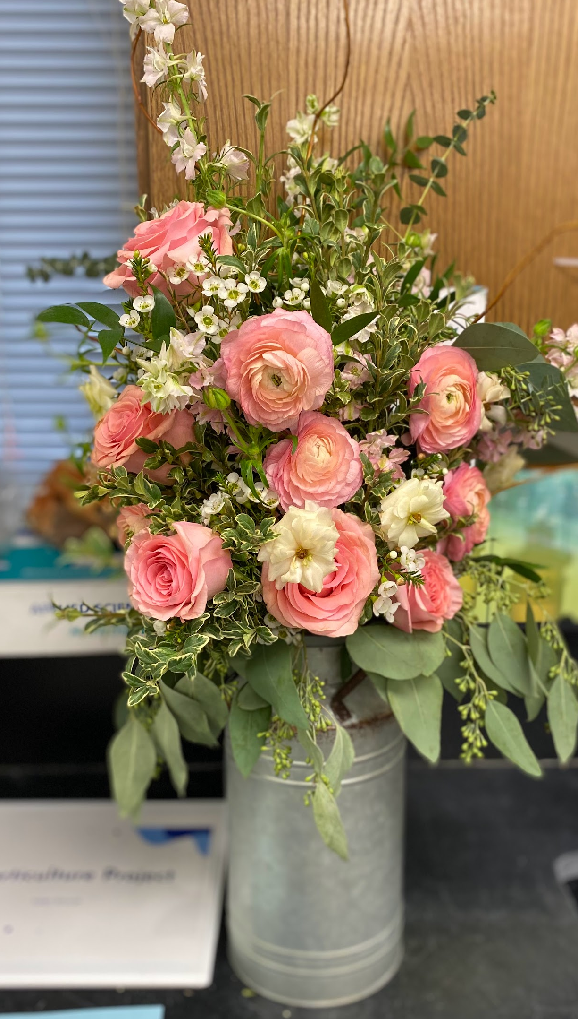
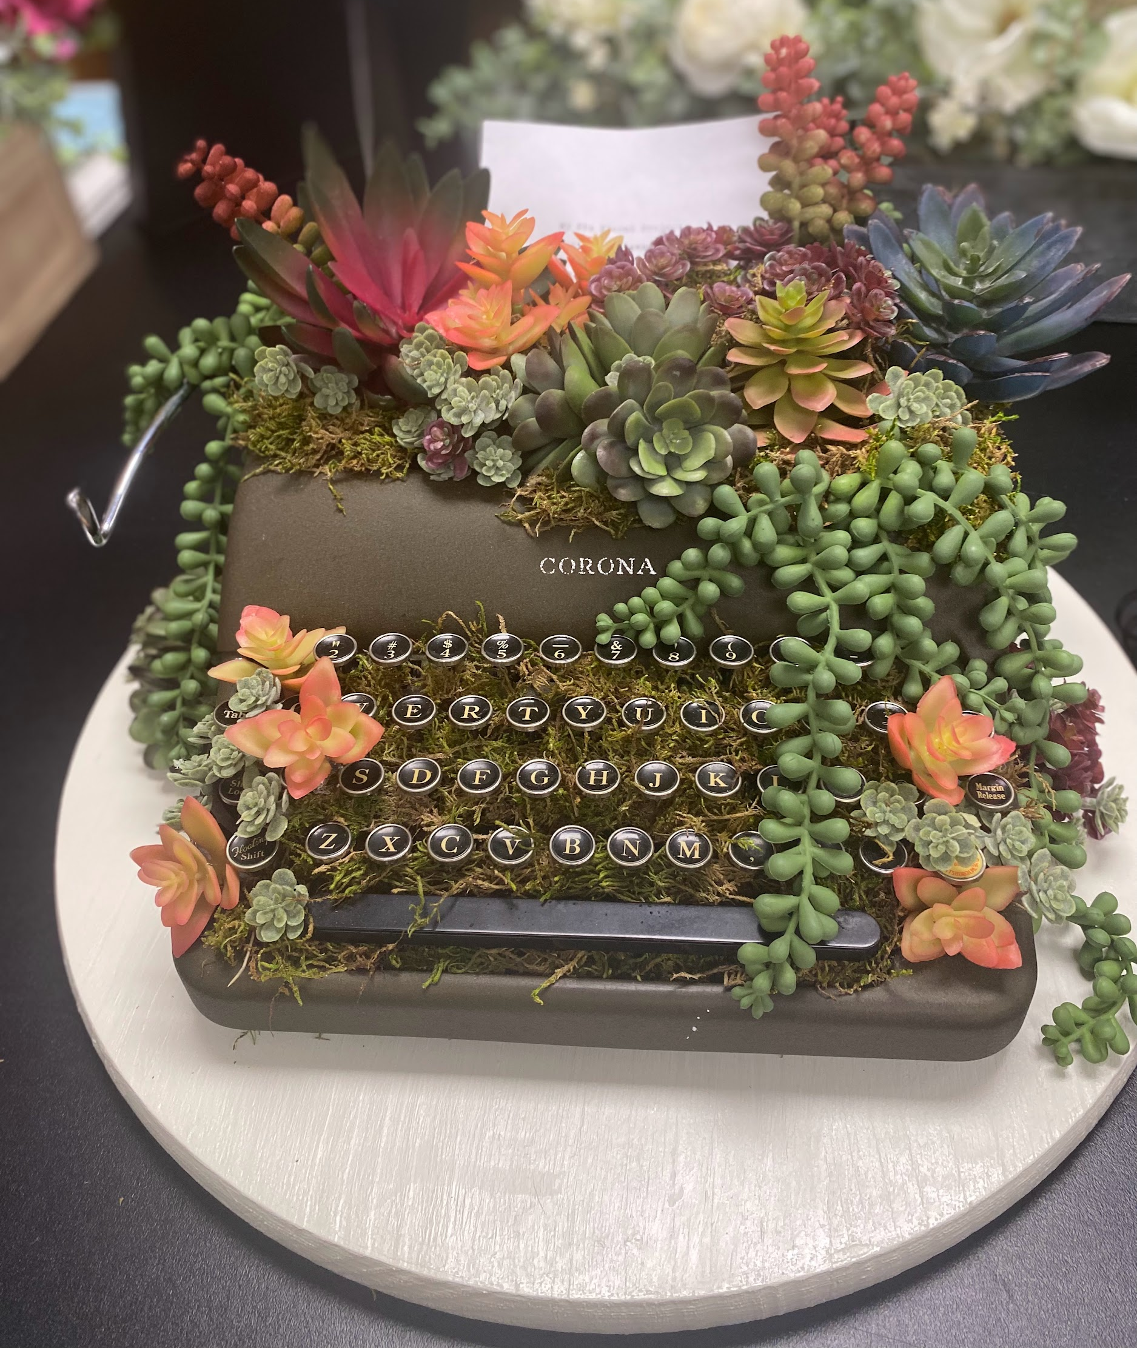
CFISD Horticulture Show
Oct. 10th - Informational Meeting
Parent and Student must attend.
Class 1: Fresh Flower Arrangement
Class 2: Cactus & Succulent Potted Arrangement
ANYONE in ANY Ag. class can participate - you do not have to be in Floral Design or Greenhouse classes
You may enter a max. of 2 projects, each in a different class
$25 entry fee + cost of project
Dates:
Nov. 1 - Class 4 plant(s) must be started
Dec. 6 - Entry must turned into Mrs. Cox or Mrs. Sadler by 2:40pm.
Remind 101:
Text @hortcyfair to 81010
CLASS 3: Creative Container Garden
CLASS 4: Potted Plant
CLASS 5: Silk Flower Arrangement
CLASS 6: Permanent Botanical Arrangement
CLASS 7: Floral Wearables
CLASS 8: Wreaths & Wall Decor

Slide 22
Official Dress Total Cost +/- $200.00
Official Dress
Official FFA Jacket
Official FFA Tie or Scarf
Black pants – jeans or dress pants
White collared shirt
Solid black boots or shoes
Solid Black Belt

Slide 23
Barn Rules
Only the students who are raising an animal at the barn are allowed at the barn.
Only family members listed on the agreement may be at the center. All should be prepared to show ID if asked by CFISD staff or police.
Students who walk over to the barn after school must be picked up or walk back across the street by 4 PM. No loitering at the barn.
One CFISD Animal per Person
Barn Hours are from 5:30 AM - 10:00 PM

Slide 24
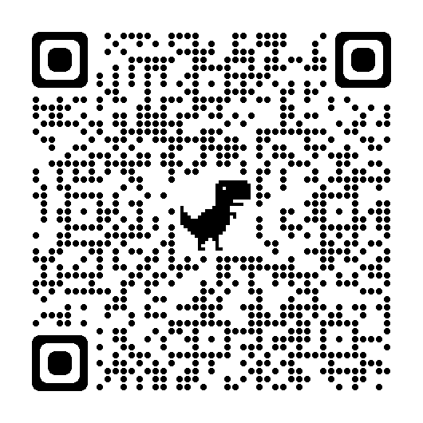
If you picked up an entry, please scan the entry and complete the google form.

